Slide 1


Brand Partnership Healthiness Diagnosis and Assessment.
An R3 Report
www.rthree.com

Slide 2
项目背景
疫情后期，中国经济缓慢回升。然而，品牌仍面临业务复苏缓慢的问题。营销人员仍然缺乏信心，在营销投入上也比较保守。"降本提效 "仍是营销的主要驱动力。
以提高营销效率和效益为最终目标，市场主迫切希望寻求一种可持续的、健康的品牌伙伴关系，以应对不断变化的市场形势，更好地支持其营销投资。
品牌如今面临的主要挑战是什么？
‘物有所值‘是追求品牌健康的合作关系的唯一标准吗？
品牌需要不同服务供应商在哪些邻域提供支持？
营销人员可以采用何种合作模式和机制来提高营销效率和效果？
通过和不同行业高管的深入访谈，结合胜三全面的营销资源的分析，我们总结了当今营销面临的主要挑战，以及如何打破这些营销壁垒，推动长期健康品牌伙伴关系的一些模型，洞察和建议。
Notes:
Take out

Slide 3
Project Background
The China economy has shown slow pickup after the Pandemic. However, the brands are still facing a slow business recovery. Marketers are still lack of confidence and are conservative in marketing investment. “Lower the cost and uplift the effectiveness (降本提效）” is still the key driver in marketing.
With the ultimate goal to drive marketing efficiency and effectiveness, the markters are eager to seek for a sustainable and healthy brand partnership to cope with the evolving market situation and better support their marketing investment.
What’s the key challenges brands are facing nowadays?
Is ‘value for money’ the only criteria to pursue a healthy brand partnership?
What kind of support brands need from different service providers?
What partnership model and mechanism marketers could apply to help drive marketing efficiency and effectivenss?
From perpectual marketing intelligence data source and cross industry executive interviews, R3 has summarized the key challenges in today’s marketing and key insights to drive a healthy brand partnership for the long run.
Notes:
Take out

Slide 4
报告概要
不断变化的市场形式 - 营销面临的主要挑战
打破营销挑战壁垒 - 品牌健康合作关系模型、洞察及建议
Notes:
Take out

Slide 5
Report Outline
What’s shaping marketing - Top Marketing Challenges.
Breaking Down Barriers to Marketing Challenges - Brand Health Partnership Model, Insights and Recommendations.
Notes:
Take out

Slide 6
THE EVOLVING MARKET SITUATION
WHAT’S SHAPING MARKETING
1
不断变化的市场形式
营销面临的主要挑战

Slide 7
不断变化的市场形势.
市场概况
中国经济的正常化。
从宏观经济角度看，中国经济呈现出积极的复苏势头。然而，居高不下的失业率和停滞不前的 CPI 仍会进一步削弱消费者的信心。
中国零售市场逐步复苏，主要由餐饮服务、奢侈品和服装食品带动。
经济前景不明朗带动理性消费行为。考虑到当前的经济环境，消费者正在减少非必要支出。
数据参考 （见附件）：
中国国家统计局

Slide 8
The evolving Market Situation.
Market Overview
THE NORMALIZATION OF THE CHINA ECONOMY.
From the macroeconoic standpoint, the Chinese economy has exhibited a positive momentum of recovery. However, the high unemployment rate and the stagnant CPI may further undermine consumer confidence.
China’s retail market staged a gradual recovery, mainly driven by Catering service, Luxury and apparel and foodwear.
Rational consumption behavior driven by uncertain economic outlook. Consumers are holding back on non-essential spending considering the current economic climate.
Data Reference:
National Bureau of Statistics of China

Slide 9
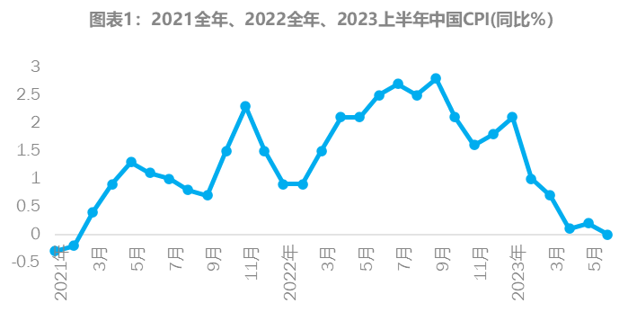
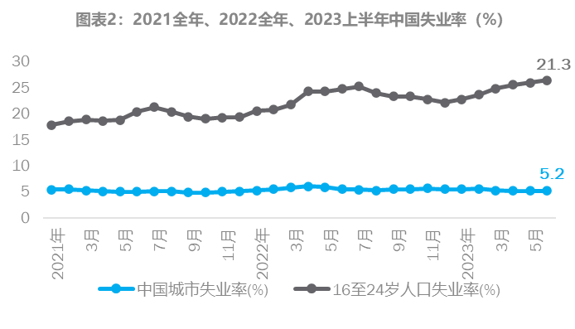
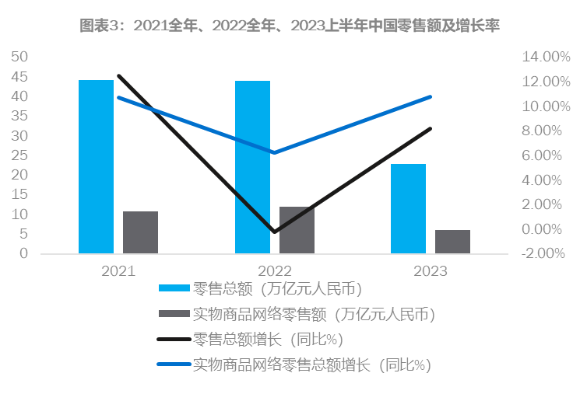
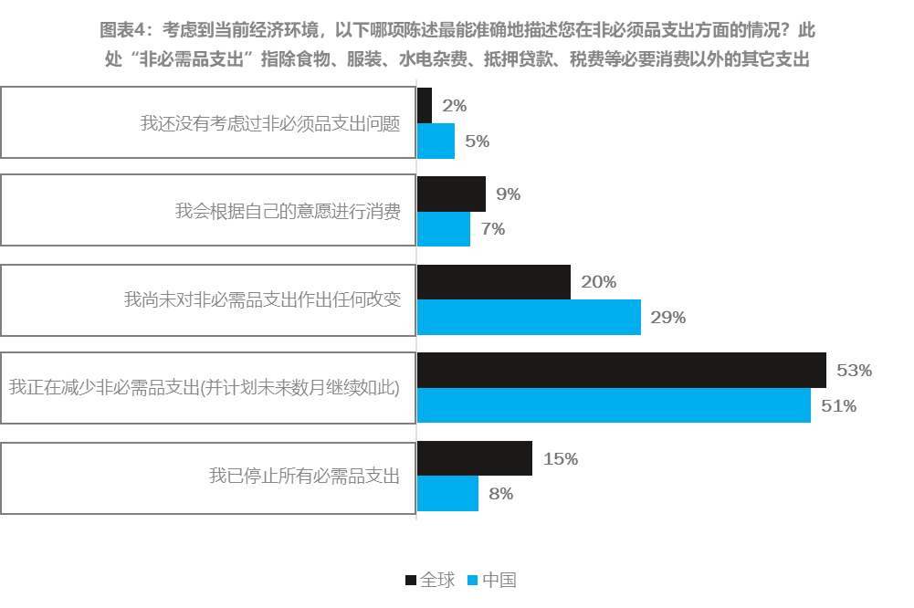
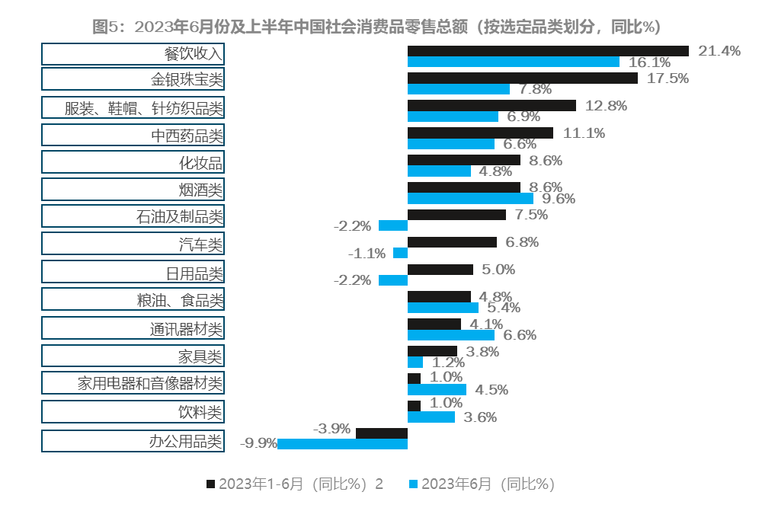
数据参考
数据参考 ：
中国国家统计局

Slide 10
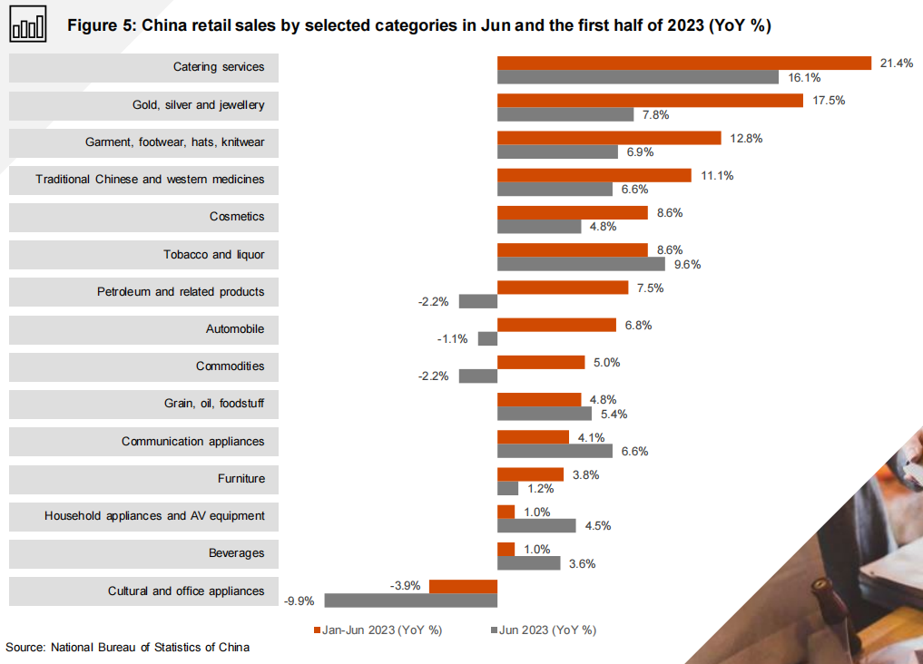
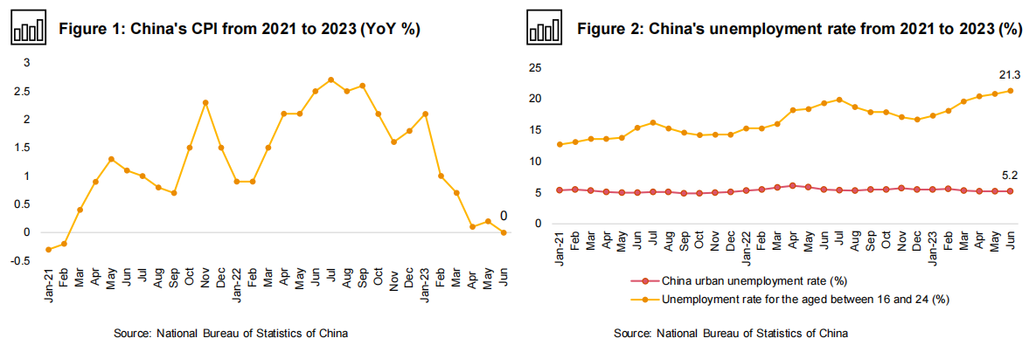
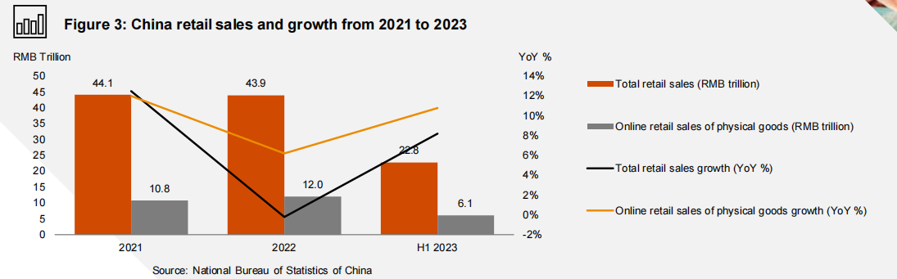
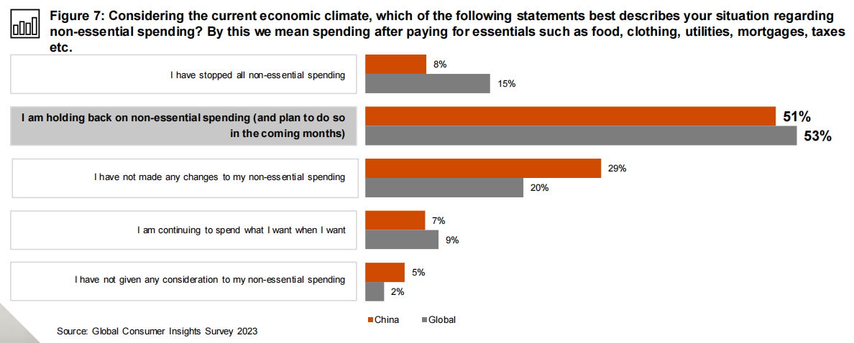
The evolving Market Situation.
Market Overview

Slide 11
不断变化的市场形势.
营销面临的主要挑战
营销面临的主要挑战.
市场信心不足。趋于多元化投资与保守投资。
平衡品牌vs业绩，长期投资vs短期投资。
营销三大关注点：营销投资回报率评估、效果的衡量和碎片化的媒体环境。
营销数字化进程。
多样化的消费者触点。 不断上升的数据壁垒。
新技术带来新的营销形式。
提高营销效果的营销工具。
社交平台的独特属性。有针对性的消费者洞察。关联内容。精准流量。
营销协同。从品牌到内容再到销售平台的打通。
客户体验管理。从公域流量到私域流量。客户忠诚度。 数据隐私。
胜三在营销领域里有着跨品类的持续的项目积累，同时每年我们也会和上百位不同企业 的营销专家进行探讨，洞察和总结不断变化的营销环境下的核心挑战和趋势。在此项研 究中，要特别感谢以下四位营销专家的深入见解：李志刚（嘉士伯集团，中国市场总 裁），冯恩（三星电子，大中华区首席市场官），李选平（林肯中国，市场营销、客户 体验及售后服务执行副总裁），宋娟娟（蒙牛集团，市场资源管理部负责人）
Notes:
外部环境“回温”，广告主对公司经营情况的信心略微下降。
2023年广告主对经济形势的信心起伏不大，整体仍高于疫情之初，但对公司经营情况的信心略微下降。
2023年营销推广费用会上升的广告主比例微降，下降与持平的比例相较去年持平，净增幅度继续收窄。

Slide 12
The evolving Market Situation.
Key Marketing Challenges
THE KEY MARKETING CHALLENGES.
Low confidence. Diversified and Conservative Investment.
Brand vs Performance. Long-term vs Short-term investment.
Marketing ROI assessment, effectiveness measurement and fragmented media environment.
Marketing digitalization.
The diversified consumer touch points. The rising data barrier.
New Technology. New Marketing Format.
The marketing tools to enhance the marketing effectiveness.
Social uniqness. Targeted Consumer Insight. Relevant Content. Precised Traffic.
Marketing collaboration. From brand to content to sales platforms.
Customer Experience Management. Public Traffic to Private Traffic. Customer Loyalty. Data Privacy.
R3 has a long track record of delivering projects across a wide range of categories, and each year we meet with hundreds of marketing professionals from a variety of organizations to gain insights and summarize the core challenges and trends in the ever-changing marketing landscape. In this study, we would like to thank the following four marketing experts for their insights:
CK Lee, President, Carlsberg China
Feng En, CMO, Samsung Greater China
Robbie Li, VP of Marketing, Customer Experience & After-sales Service Lincoln
Selina Song, Head of Marketing Resource Management, Mengniu
Notes:
外部环境“回温”，广告主对公司经营情况的信心略微下降。
2023年广告主对经济形势的信心起伏不大，整体仍高于疫情之初，但对公司经营情况的信心略微下降。
2023年营销推广费用会上升的广告主比例微降，下降与持平的比例相较去年持平，净增幅度继续收窄。

Slide 13

1. 市场信心不足。
趋于多元化投资与保守投资。

Slide 14
1. Lack of confidence.
Diversified and Conservative Investment.

Slide 15
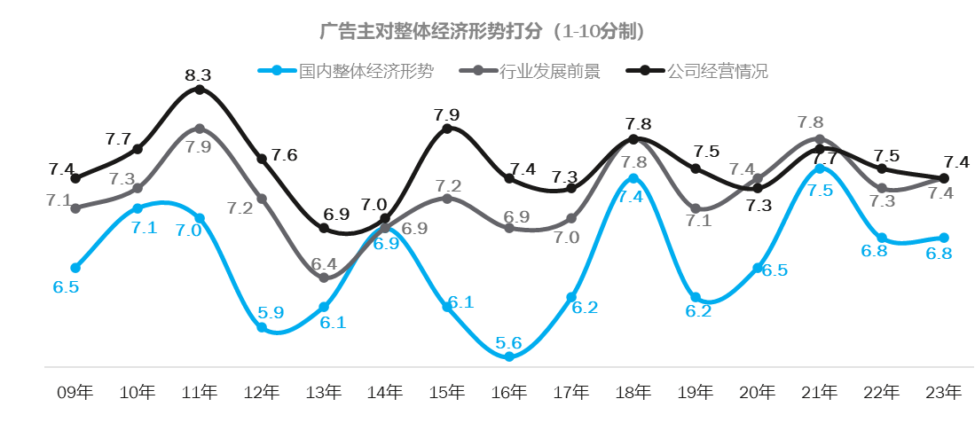
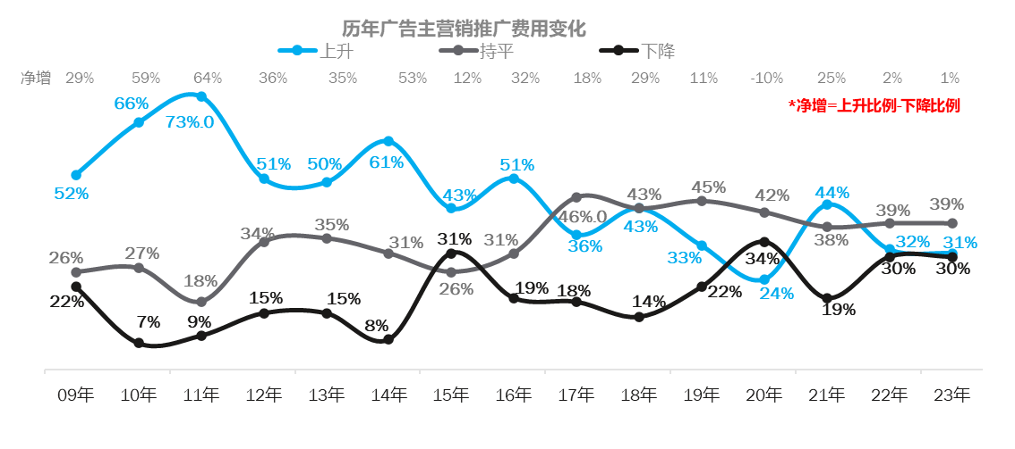
不断变化的市场形势.
营销面临的主要挑战
尽管经济环境 "缓慢上升"。品牌仍对经营业绩缺乏信心，从而影响了营销预算的投入。
Data Reference:
CTR央视市场研究 - 2023中国广告主营销趋势调查报告

Slide 16
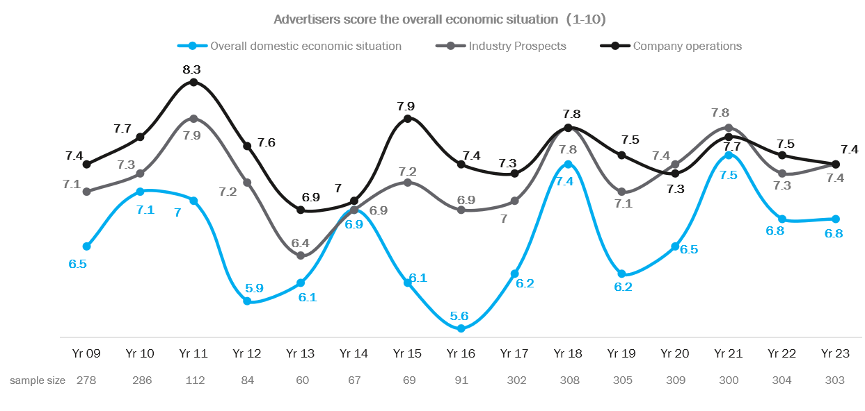
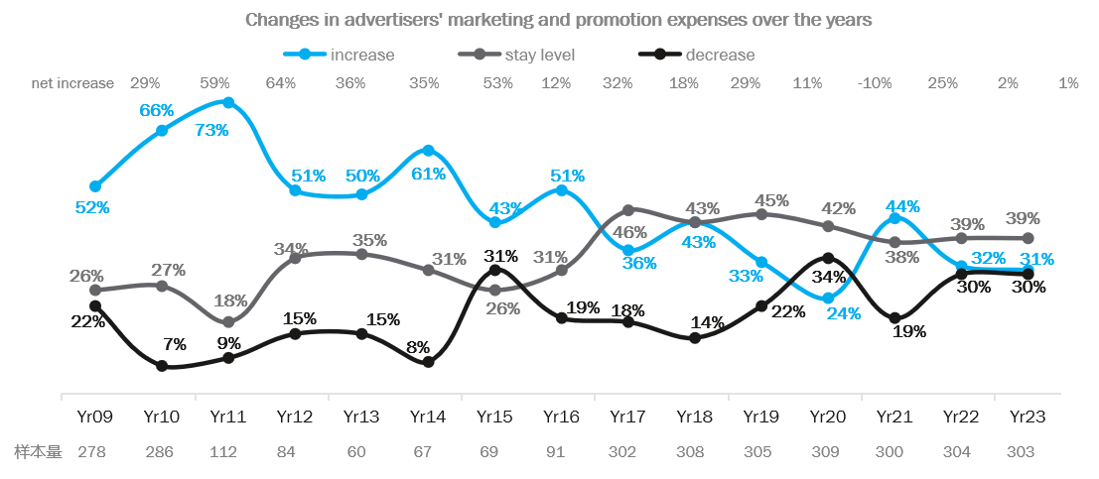
The evolving Market Situation.
Key Marketing Challenges
Despite the ‘slow rising’ economic environment. Brands are still lack of confidence in business performance, which impacts the marketing budget investment.
Data Reference:
CTR央视市场研究 - 2023中国广告主营销趋势调查报告

Slide 17
Data Reference:
CTR央视市场研究 - 2023中国广告主营销趋势调查报告
The evolving Market Situation.
Key Marketing Challenges
sample size 278 286 112 84 60 67 69 91 302 308 305 309 300 304 303

Slide 18
The evolving Market Situation.
Key Marketing Challenges
net increase 29% 59% 64% 36% 35% 53% 12% 32% 18% 29% 11% -10% 25% 2% 1%
样本量 278 286 112 84 60 67 69 91 302 308 305 309 300 304 303
Data Reference:
CTR央视市场研究 - 2023中国广告主营销趋势调查报告

Slide 19
2. 平衡品牌vs业绩，长期投资vs短期投资。

Slide 20
2. Brand vs Performance.
Long-term vs Short-term investment.

Slide 21
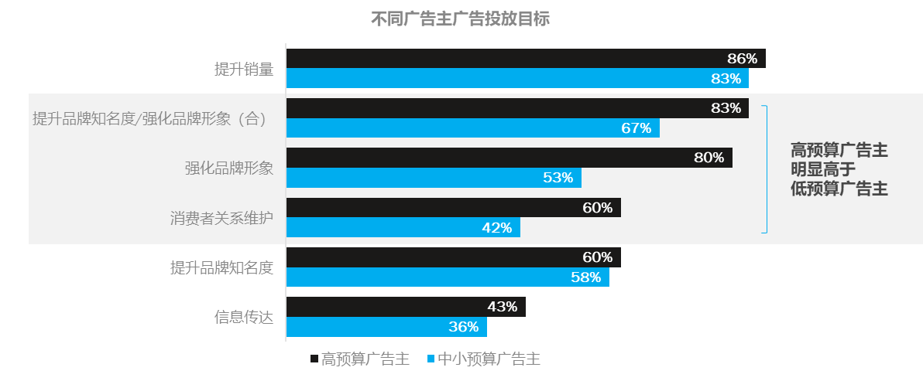
不断变化的市场形势.
营销面临的主要挑战
“
由于商业竞争压力增大，绩效营销预算呈上升趋势。
然而，成熟的高营销预算品牌仍倾向于在品牌和绩效营销投资之间取得平衡，而中小预算品牌则更多地投资于绩效营销。
在众多的碎片化的传播资源中，我们始终是保持着比较冷静的审视态度来进行筛选和投入的，当前趋势下，互联网风潮的褪去让流量祛魅，而不唯流量论也是我们一贯的做法，我们的投入始终聚焦在与品牌力打造相契合的资源上，追求长远的强品牌力塑造。
大家一味关注降本增效，追求以效果为导向的同时，也容易让品牌主丧失品牌力长效的增长。
”
Data Reference:
【秒针营销科学院】2023中国数字营销趋势报告

Slide 22
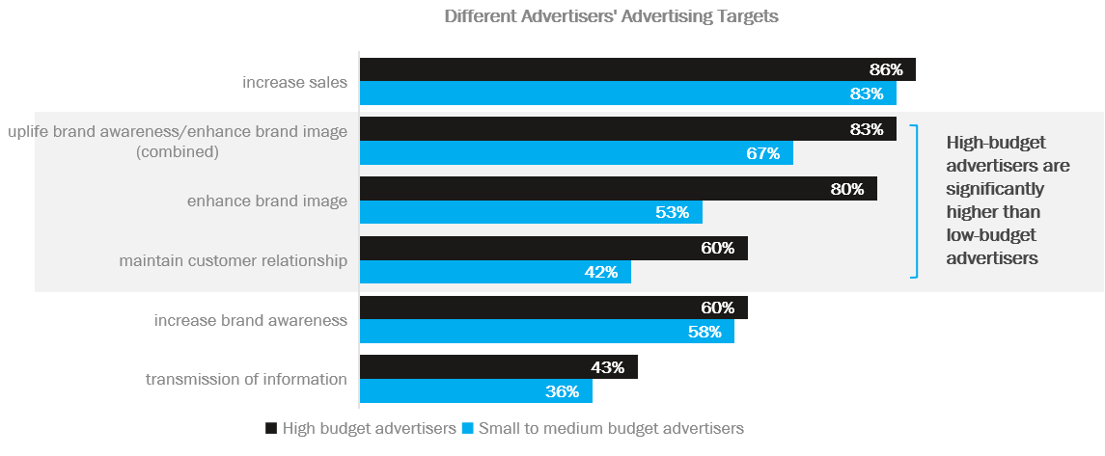
The evolving Market Situation.
Key Marketing Challenges
“
An uplifting trend in increasing the performance marketing budget due to the high competitive business pressure.
However, mature and high marketing budget brands tend to strike a balance in brand & performance marketing investment, whilst medium to small budget brands invest more on performance marketing.
In the many fragmented communication resources, we always maintain a relatively calm attitude to screen and to invest. Under the current trend, our investment is always focused on the resources that match with the building of brand power, and the pursuit of long-term strong brand development.
While we are focusing on cost reduction and efficiency, and pursuing results-oriented, it is also easy for brand owners to lose the long-term growth of brand power.
”

Slide 23
High-budget advertisers are significantly higher than low-budget advertisers

Slide 24




案例一深入洞察市场把握机会点、实现品牌力长效增长
背景
R3做法
成果
>
>
行业品类
3C Electronics Brand
背景信息
在一个对媒体投放高度依赖的行业中，客户持续面临着如何通过差异化营销脱颖而出的挑战。品牌致力于在多媒体的喧嚣中，精准地定位其品牌，使每一分投入都转化为最大的品牌价值。
市场和消费者洞察
通过持续的市场调研和对不同消费者画像的深入分析，识别核心的营销机会点
广告效果与·策略性评估
持续追踪广告反响，同步调整策略以适应消费者喜好。结合线下活动分析，优化未来营销决策
精准追踪目标客户反馈
密切监测消费者反馈，提供关键洞察，为品牌长期增长提供了数据驱动的指导
推动品牌力的长效增长：通过精准的市场定位和有效的广告投放，不断增强品牌与消费者之间的联系
从数据中把握营销机会：洞悉市场动态，为品牌策略实施提供了明确的方向
提升广告有效性：这些洞察成为了品牌的有力抓手，极大地增强了未来广告投放的针对性和有效性

Slide 25
Case Study 1
Continued Study on Brand and Market to Seize Opportunities and Achieve Sustained Brand Growth
Context
Approach
Impact
>
>
Client
3C Brand
Background
As client constantly faces the challenge of standing out through differentiated marketing. The brand is committed to precisely positioning itself amid the multimedia clamor, ensuring every investment maximizes brand value.
Market and Consumer Insights
Ongoing market research and detailed analysis of various consumer profiles identify key marketing opportunities
Media Impact Evaluation & Optimization
By continuously tracking advertising responses and adjusting strategies to align with consumer preferences, coupled with offline activity analysis, to sharpen future marketing tactics
Constant Study on Consumer Mindset Shift
Close monitoring of consumer feedback provides crucial insights, offering data-driven guidance for the brand's long-term growth
Driving Sustained Brand Growth: Accurate market positioning and effective advertising continuously strengthen the connection between the brand and its consumers
Data-driven Marketing Insights: Insights into market dynamics give clear direction to the implementation of brand strategies
Enhancing Campaign Effectiveness: These insights are leveraged to heighten the focus and effectiveness of future campaigns

Slide 26
3. 营销三大关注点
营销投资回报率评估
效果的衡量
碎片化的媒体环境

Slide 27
3. Three key marketing challenges
Marketing ROI
Effectiveness Measurement
Fragmented Media Environment

Slide 28
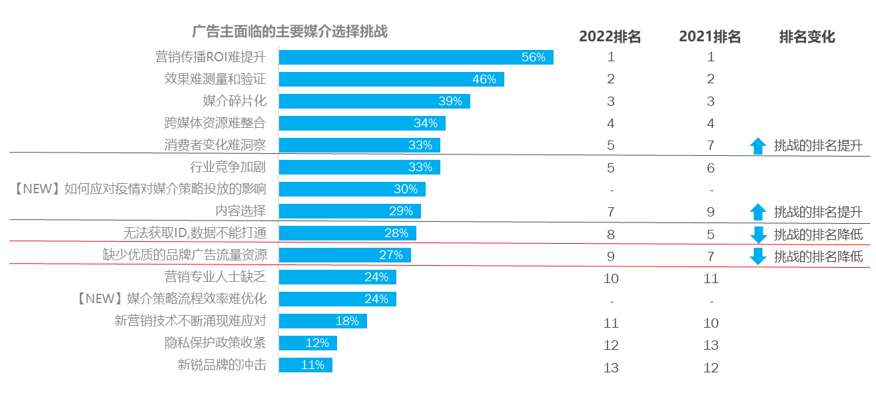
不断变化的市场形势.
营销面临的主要挑战
“
Omni channel的选择越来越多。尤其是O to O的平台，以前主要是天猫京东，现在流量下降，也出现了并转换到其他的平台。O to O，即是购买的平台，也是品牌露出的平台。品牌投入力度逐步加大。如何有效评估对平台的投入是个持续的挑战。平台产出是否对标，有效性KPI如何设定，内容的有效性，传统意义上衡量ad的方式方法是否能用上。目前还没有看到完整链路的KPI。
营销投资回报率评估、效果衡量和碎片化的媒体环境仍是品牌面临的主要挑战。
Data Reference:
【秒针营销科学院】2023中国数字营销趋势报告

Slide 29
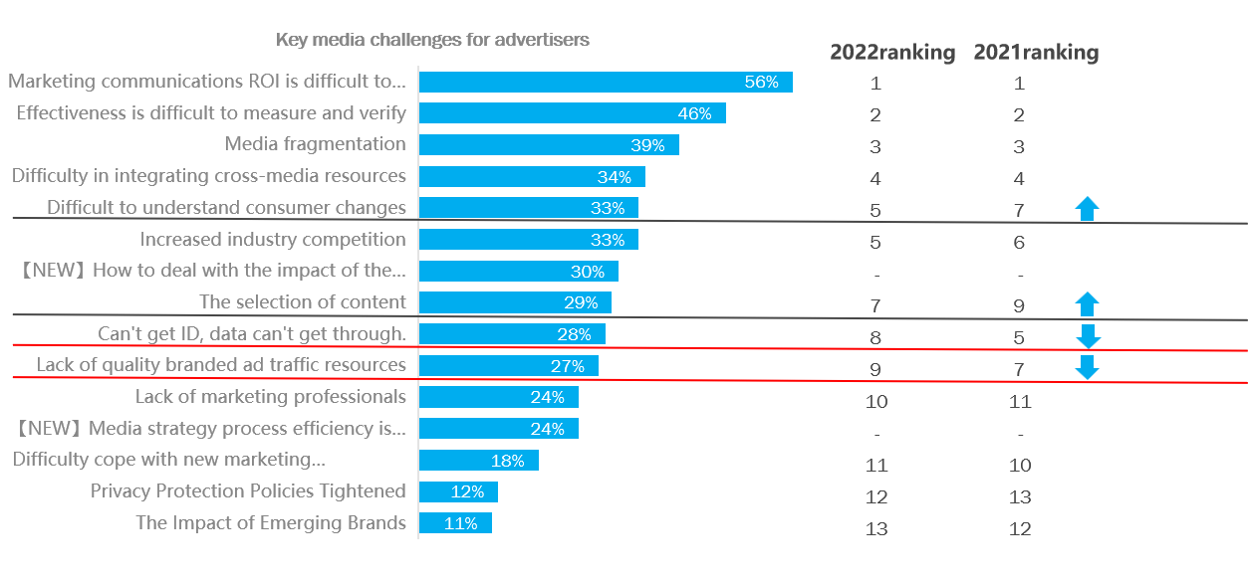
The evolving Market Situation.
Key Marketing Challenges
“
The choice of omni-channels is growing. Especially online to offline (O to O) platforms. It is the platform of purchase, but also the platform of brand exposure. Previously, it was mainly Tmall and Jingdong. But now the traffic of the big platforms is declining, and more and more decentralized. Other platforms have also appeared. Brand investment is gradually increasing. How to effectively evaluate the investment in the platform is an ongoing challenge. Whether the platform output is on target, how the effectiveness KPI is set, the effectiveness of the content, and whether the ways and means of measuring ad in the traditional sense can be used. At present, we have not seen the KPI of the complete chain.
Marketing ROI assessment, effectiveness measurement and fragmented media environment are still the key challenges for brands.
”
”

Slide 30
2022ranking
1
2
3
4
5
5
-
7
8
9
10
-
11
12
13
2021ranking
1
2
3
4
7
6
-
9
5
7
11
-
10
13
12

Slide 31
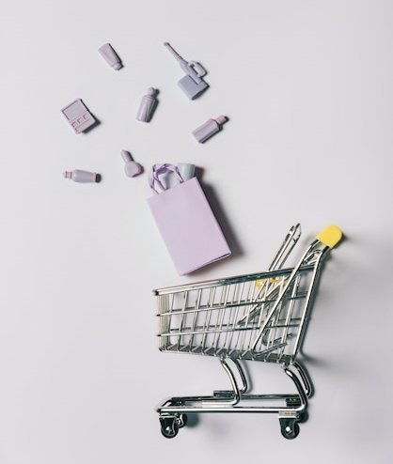

案例二
营销投资逐个击破、掌握市场动态以驱动营销回报率
背景
R3做法
成果
>
>
行业品类
消费品集团
背景信息
该消费品集团随着高速的业务增长，其花费也达到了较高规模，而日益增长的营销资产投入及日益复杂的结构为期带来了诸多管理挑战。
梳理营销投资，判断风险
在“抓大放小”大原则下，R3帮助该集团梳理各版块营销投资，并根据企业现状、外部趋势、行业数据综合评定其风险，并制定优化路径
ROI的显著提升：综合的内外部优化措施，包括对外部信息的有效整合与管理体系的细致优化，有助于全面提升运营效率，并推动整体投资回报率的增长
“检视-洞察-学习-优化”逐个击破各投资板块
利用R3独有的营销咨询数据库及工具，帮助该集团诊断营销资产，并通过市场对标及内部洞察进行问题发现及探索，最终针对于每个特定的营销资产提出了在多个层面的结果方案，包含职能设计、流程优化、数据库建立及管理工具等。
管理方法的有效优化：新流程显著提升决策效率和团队合作，内部决策链路和职能分配及外部代理商协调均得到细致优化，整体工作效能得到加强
透明度增强：增强了价格管理及信息流通的透明度，有效降低管理风险

Slide 32
Case Study 2
Driving Marketing Investment ROI by Sectors
Context
Approach
Impact
>
>
Client
FMCG Group
Background
As the group is witnessing a rapid business growth, its marketing investment also reached a high scale. The increasing investment in marketing assets and the growing complexity of the structure brought about numerous management challenges.
Bringing clarity on marketing investment and identify potential risks
R3 helped reorganizing the group's marketing spend across sectors by assessing risks against the current brand status quo, external trends, and industry insights to devise a strategic optimization plan.
Targeted ROI optimization by each investment sector
Utilizing R3's unique marketing consultancy database and tools, the group was aided in diagnosing marketing assets. Market benchmarking and internal insights pinpointed issues, leading to tailored, comprehensive solutions for each marketing asset that encompassing R&R redesign, process optimization, database establishment, and management tools integration.
ROI Increased: Strategic optimizations led to improved operational efficiency and increased ROI
Internal Organization Enhanced: Streamlined processes boosted decision-making and teamwork, while fine-tuning internal and external coordination enhanced overall performance
Transparency Improved : Transparency in pricing management and information flow was heightened, effectively minimized management risks

Slide 33
4. 多样化的消费者触点。
不断上升的数据壁垒。

Slide 34
4. Diversified Consumer Touchpoints.
The Rising Data Barriers.

Slide 35



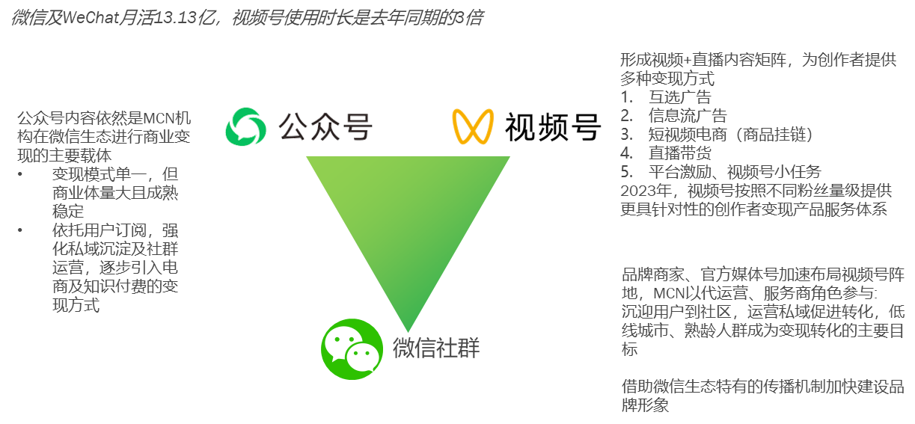
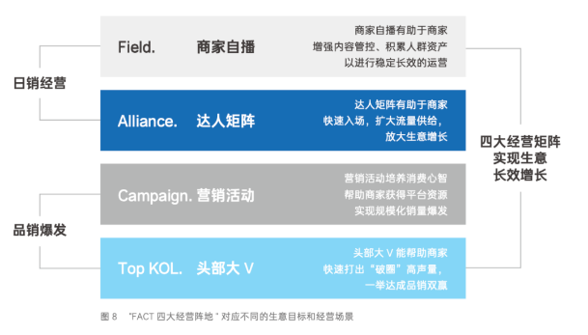
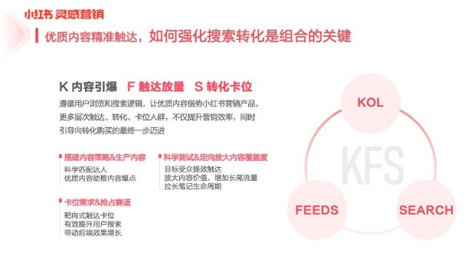
不断变化的市场形势.
营销面临的主要挑战
“
与媒体的合作要走定制化趋势，千人千面。阿里系头条系等，都在强调更加精准的投放，可是提供给广告主的往往只是套餐的权益。但是现在在各个媒体信息壁垒下，信息保护法的驱动下，广告主的“营销权力”进一步被削弱。
传播渠道的碎片化乃至粉尘化发展，各媒体创新乏力，互联网红利终结等等也给我们的资源投放带来巨大的挑战，消费者信息接触渠道越多，能够影响他们在决策路径上的触点也越多，如何能更精准的触达更多的目标受众，如何能在现有传播资源中实现突破做到更有效的与消费者心智共振，就是我们营销资源投放要解决的一大难题；资源精准，数据横向打通，资源优化。与平台的谈判逻辑等都需要产生变化。
不同媒体平台上的消费者接触点分散、孤立且复杂。不断上升的数据壁垒问题也在不断降低品牌方对营销投资的控制力。
”

Slide 36
Wechat Public Account, Video Account, Private Domain Community Triangle Model
Formation of video + live content matrix, providing creators with a variety of ways to realize cash.
1.Mutual Selection Ads
2.Infomercials
3.Short video e-commerce (goods hanging chain)
4.Live streaming with goods
5.platform incentives, video number small task 2023, video number in accordance with different fan level to provide more targeted creators cash product service system
wechat & wechat Monthly activity 1,313 million, Video Account used three times as long as last year
Public Account content is still the most important factor for MCN organizations to realize commercialization in the WeChat ecosystem.
Single mode of realization, but large and stable commercial volume
Relying on user subscription, strengthen the precipitation of private domain and community operation, and gradually introduce the realization mode of e-commerce and knowledge payment.
Public Account
Video Account
Brand merchants and official media numbers accelerate the layout of video account positions, MCNs participate in meeting users to the community in the role of operation and service providers, operate private domains to promote conversion, and low-tier cities and mature age groups become the main targets of cash conversion.
Accelerating the construction of brand image with the unique communication mechanism of WeChat ecosystem.
Wechat Community

Slide 37
Douyin launches the "FACT" Four Matrix Business Growth Methodology
day-to-day marketing
Field.
Merchant Self-Play
  Merchant self-broadcasting helps merchants enhance content control and accumulate crowd assets for stable and long-lasting operation
Alliance.
Daren Matrix
  Daren Matrixhelps merchants to enter the market quickly, expand traffic supply, and amplify business growth
brand and sales explosion
Campaign.
  Marketing campaign to cultivate consumer mindset, help marketers to obtain platform resources and achieve large-scale sales explosion
Top KOL.
  Top KOLs can help marketers rapidly create a "break out the circle" of high volume and achieve double winss in both branding and sales.
Four Business Matrices
help Realize Business
Long-term growth
”
Figure 8 "FACT four business positions" correspond to different business objectives and business scenarios

Slide 38
Little Red Book Launches NFS's Seeding Integrated Marketing Methodology
Little Red Book Inspired Marketing
Quality content reaches precisely, how to strengthen search conversion is the key to the mix
K content detonation F reach volume S conversion position
Follow the logic of user browsing and searching, using high-quality content to marketing products leveraging the Little Red Book platform, more levels of reach, conversion, position of the crowd, not only to enhance the marketing efficiency, but also to guide the conversion of the final step of the purchase!
Building Content Strategy & Producing Content
Scientific Matching
Premium content to drive content explosion
Capture the demand and seize the track
Targeted Reach
Increase monthly household searches
Drive back-end results
Scientific testing & targeting to amplify content reach
Target Audience Reach
Amplify content value and increase long-tail traffic
Lengthen the life cycle of notes
”

Slide 39



案例三
全面优化社交媒体营销，驱动社交营销效能增长
背景
R3做法
成果
>
>
行业品类
汽车集团
背景信息
无论是在支出规模还是管理复杂性方面，KOL支出逐渐在客户的营销中占据主导地位。客户面临管理复杂性提升和效果优化的双重挑战。
面对不断增长的预算压力和管理挑战，集团急需通过外部情报的洞察与内部流程的全面优化，实现成本的有效控制与效率的提升，以增强未来营销活动的精准性和影响力。
针对性的市场实践扫描
吸收行业领先的营销实践，深入分析竞争对手策略和市场趋势，为营销决策提供洞察支持。
360 社交营销透明度诊断
对过去两年的KOL支出进行了全面评估，包括成本、费用及其绩效。明确与市场标杆的差距，并为优化策略提供数据支持。
管理流程和工具的建立
依托于在诊断的基础上，R3根据客户的营销目标和团队现状，重新设计了内部协作最优流程。并且还开发了一套实用工具以支持流程改进。
行业最佳实践参考：针对性的策略支持，确保营销决策与行业领先标准一致
支出效能的提升：通过优化管理和调整流程，用更少的预算撬动目标客户的精准触达
内容有效性的最大化：确保每次社媒投放都能产生最大的影响力和参与度
管理工具的定制化创新：开发了新工具，支持策略执行和持续的流程改进

Slide 40
Case Study 3
Comprehensive Optimization of Social Media Marketing from Inside Out to Drive Growth in Marketing Efficacy
Context
Approach
Impact
>
>
Client
Auto Group
Background
KOL expenditures are increasingly dominating the client's marketing budget, presenting a dual challenge of managing complexity and optimizing effectiveness. Facing rising budget pressures and management challenges, the group urgently needs to leverage external intelligence and thoroughly optimize internal processes to control costs and improve efficiency, thereby enhancing the precision and impact of future marketing activities.
Targeted Social Marketing Practice Scan
Incorporate industry-leading marketing practices and in-depth competitor strategy and market trend analyses to inform & support marketing decisions
360-Degree Social Marketing Transparency Diagnosis
Conduct a thorough review of KOL spend over the past two years, including costs and performance, to identify gaps with market benchmarks and provide data support for optimization strategies
Management Processes and Tools Development
Based on the diagnostic findings, R3 redesigned the internal workflows and practical tools to align with the client's marketing goals and the team's current state
External Intelligence Input: Align marketing initiatives with top-tier industry practices
ROI Improvement: TA reached more accurately with optimized spending
Maximization of Content Effectiveness: KOL marketing is optimized to achieve maximum impact and engagement.
Management Tools Innovation: New tools were developed to facilitate strategic implementation and continuous process enhancement.

Slide 41
5. 社交平台的独特属性，有针对性的消费者洞察，关联内容，精准流量.

Slide 42
5. Social Platform Uniqness.
Targeted Consumer Insight.
Relevant Content.
Precised Traffic.

Slide 43
The evolving Market Situation.
Key Marketing Challenges
“
对于成熟品牌。重点是内容和口碑。红书抖音微信公众号，网站论坛各有不同，应该做什么内容。BGC，PGC, UGC, 内容如何规划。Cost怎么分配。细节上如何操作。需要好的agency去规划这些。
对于social media agency的要求，需要理解品牌的整体要求下，把握好Dos and Don’t, 如何抓住social channel好玩的特性和传播品牌正面信息能量上做到一个平衡。而不是照搬传统media的campaign投放的模式。也不是单纯的对brand team thematic strategy的一个延展。
年轻人的意识形态。和年轻人的知识获取不一样，年轻人在移动互联的信息摄取非常碎片化。年轻人喜欢纯粹没有见过的东西。年轻人的风格多变，新奇，交友圈非常的vertical。如何精准触达年轻人群并真正抓住他们的心理去定制相应的内容去吸引他们。
识别不同社交媒体平台的独
特属性价值，发现真正的消
费者洞察。并据此制定相关
的内容策略，以推动精准的
流量。
”

Slide 44
The evolving Market Situation.
Key Marketing Challenges
“
For established brands. The focus is on content and word of mouth. Red book Tiktok WeChat, website forums are all different, what content should be done. BGC, PGC, UGC, how to plan the content, how to allocate the Cost, how to operate in details. We need a good agency to plan these. For the requirements of social media agency, we need to understand the overall requirements of the brand, grasp the Dos and Don't, how to seize the fun characteristics of social channel and spread the brand's positive information and energy to achieve a balance. Instead of copying the traditional media campaign placement model. It's not just an extension of the brand team's thematic strategy. To capture young people's ideology. Young people's information intake in mobile internet is very fragmented. They are attracted to new things. Young people's styles are diverse, novel, and their friendship circles are very vertical, so how to precisely reach them and really capture their psychology to customize content to attract them.
Recognize the unique value from different social media platforms to help discover the real consumer insights. And develop relevant content strategy accordingly to drive precised traffic.
”

Slide 45
6. 营销数字化进程

Slide 46
6. Marketing Digitalization

Slide 47
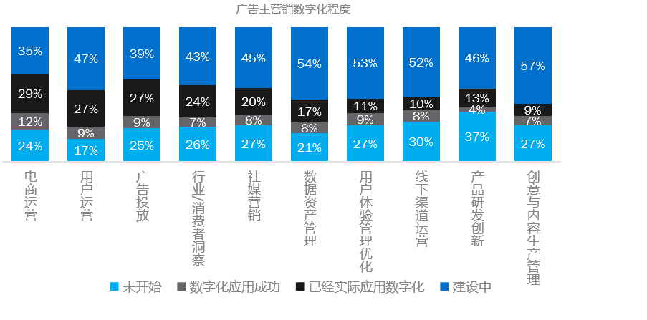
不断变化的市场形势.
营销面临的主要挑战
“
营销数字化仍是大势所趋，但不同营销领域的发展和准备情况却有很大差异。
这两年很明显在加大直播电商投入。另外就是这两三年公司内部成立了专门的直播电商数字营销部门，目前更多与天猫等电商平台合作。
用户精细化运营是趋势。通过捕捉新消费需求，紧贴用户偏好，不断研发产品。一方面，通过对消费习惯、商品偏好、复购留存等消费者画像数据进行综合分析，判断其客群购买力与消费偏好，挖掘消费者更多个性化的需求；另一方面，将会员层级细分，实现千人千面精细化运营，从而形成以消费者为中心，覆盖消费者全生命周期的全场景分析，以此为依据快速研发迭代打造差异化产品。
”
Data Reference:
【秒针营销科学院】2023中国数字营销趋势报告

Slide 48
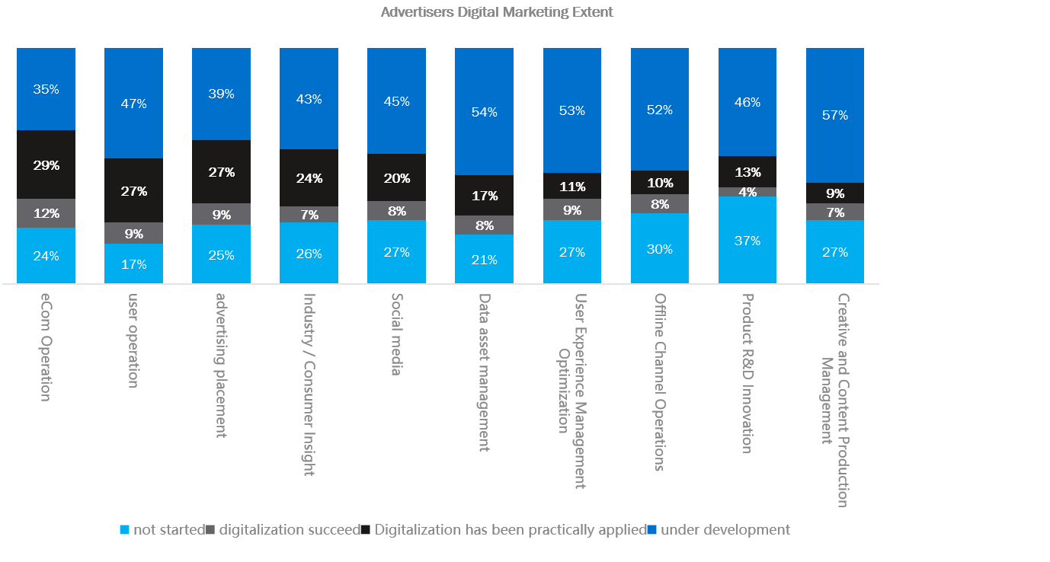
The evolving Market Situation.
Key Marketing Challenges
“
Marketing digitalization is still the rising trend, yet the development and readiness from different marketing areas have big variance.
These two years the live e-commerce investment is increasing. The company has set up a special live e-commerce digital marketing department and is now cooperating more with e-commerce platforms such as Tmall. User refinement operation is the trend. By capturing new consumer demand and keeping close to user preferences, we continue to develop products. On the one hand, through a comprehensive analysis of consumer profile data such as consumption habits, product preferences, repurchase retention, etc., to determine the purchasing power and consumption preferences of its customer base, and to tap into the more personalized needs of consumers; on the other hand, the membership hierarchy will be subdivided, to form a consumer-focused analysis of the whole scenario covering the entire lifecycle of the consumer, which will serve as the basis for the research and development of differentiated products.
”

Slide 50
7. 提高营销效果的营销工具。

Slide 51
7. New Marketing Tool to Enhance Marketing Effectiveness.

Slide 52
不断变化的市场形势.
营销面临的主要挑战
“
公域私域的数据整合，非同源数据如何建模打通，结合所在行业诀窍的营销知识图谱，这是提升营销技术能力的三个基础工作。
越来越多地使用营销工具来帮助提高营销效果，如内容标签、DMP（数据中间平台）、CDP（客户数据平台）、第三方数据供应等。
”

Slide 53
The evolving Market Situation.
Key Marketing Challenges
“
The growing usage of the marketing tools to help enhance the marketing effectiveness. eg. content labeling, DMP(data middle platform), CDP (customer data platform), 3rd party data supplyment etc.
Data integration of public and private domains. How to model non-homologous data to bridge the gap. Combining the marketing knowledge graph with the knowhow of the industry. These are the three basic tasks to improve the marketing technology capability.
”

Slide 54
8. 新技术带来新的营销形式。

Slide 55
8. New Technology. New Marketing Format.

Slide 56
不断变化的市场形势.
营销面临的主要挑战
“
广告的展现方式更加多样化，创新广告形式将不断涌现。技术提升所带来的必然。数字广告肯定会突破 “广告位的边框 ” 。
新技术带来新的营销形式，以吸引和丰富客户体验，如 元宇宙、虚拟代言人等。
”

Slide 57
The evolving Market Situation.
Key Marketing Challenges
“
The presentation of advertisements has become more diversified, and innovative advertising forms will continue to emerge. Inevitability brought about by technological enhancement. Digital advertising will definitely break through the "border of traditional advertising limits ".
New technology leads to new marketing format to engage and enrich customer experience. eg, Meta Verse, Virtual Spokespersonetc.
”

Slide 58
9. 营销协同。
从品牌到内容再到销售平台的打通。

Slide 59
9. Marketing Collaboration.
From Brand to Content to Sales Platforms.

Slide 60
不断变化的市场形势.
营销面临的主要挑战
“
跨界营销。如何跳出传统框架，有效利用跨界营销等方式放大投入的资源，同时利用品牌方和其他品牌跨品类的力量。
品牌、营销内容，销售间大家怎么去协同，而不是各自为战，不能电商团队做电商，品牌团队做品牌， 需要有相互的协同。
品牌需要共识基础，不能把大部份或所有预算放某一个大平台上，三个领域，品牌展示、内容运营，销售平台都要覆盖。
通过创造更多营销机会来增加品牌曝光率和销售机会，从而实现营销投资回报最大化。营销预算分配需要涵盖三大领域：品牌曝光、内容管理和销售平台。
”

Slide 61
The evolving Market Situation.
Key Marketing Challenges
“
Collaboration. Cross Over. How to amplify the resources invested, and at the same time utilize the power of the brand and other brands cross category. How to synergize between branding, social content, and sales, instead of working separately. You can't have an e-commerce team doing e-commerce and a branding team doing branding, you need to have mutual synergy. Brands need to agree on the basis, can not put most or all of the budget on a single large platform. Three areas, brand display, content operation, sales platform should all be covered.
Maximize the return of marketing investment by creating more marketing occassions to increase brand exposure and sales opportunities. e.g Collaborations, cross category marketing. Marketing budget allocation to cover three major areas: brand exposure, content management, and sales platforms.
”

Slide 62
10. 客户体验管理。
从公域流量到私域流量。
客户忠诚度。
数据隐私。

Slide 63
10. Customer Experience Management.
Public Traffic to Private Traffic.
Customer Loyalty.
Data Privacy.

Slide 64
不断变化的市场形势.
营销面临的主要挑战
“
消费者参与的渠道和方式方法都发生了改变。导致消费者的决策周期也大大的缩短了 （从看到品牌，想起品牌，到喜好品牌和选择品牌的整个链路）。社交媒体平台和KOL/KOC的影响也越来越多，越来越大。
线下触点和线下营销形式增多。除了传统4S店也做很多试乘试驾，热点中庭展示等等。线下营销的成本都在提高。如何把渠道运营和营销有效结合在一起。提供一个完整的品牌体验和消费者体验。同时也扩大投入和产出。
随着中国消费者更加谨慎地消费观念，提供无缝、无摩擦的客户体验，已成为帮助吸引和留住消费者的关键差异化因素。(在这种情况下，从品牌浏览和研究、购买渠道到送货和客户维护，每一个接触点都旨在优化客户体验）。
”

Slide 65
The evolving Market Situation.
Key Marketing Challenges
“
The channels and methods of consumer engagement have changed, resulting in a much shorter decision making lead time for consumers (from seeing a brand to thinking about it, to liking it and choosing it). The influence of social media platforms and KOLs/KOCs is also increasing and becoming more and more significant. There are more and more offline contact points and forms of offline marketing. In addition to the traditional 4S stores, we also do a lot of test drives, hot atrium displays and so on. The cost of offline marketing are increasing. How to effectively combine channel operation and marketing together. Provide a complete brand experience and consumer experience. At the same time also expand the input and output.
With Chinese consumers resorting to more cautious spending, providing a seamless and frictionless customer experience has become an important non-price key differentiator to help attract & retain consumers. (where every touch point - from browsing and researching, channel of purchase, to delivery and customer support - is designed to optimize the customer experience.)
”

Slide 66
如何打破营销挑战壁垒
品牌健康合作关系模型、洞察及建议
2

Slide 67
Break Down Barriers to Marketing Challenges
Brand Healthy Partnership Model, Insights and Recommendations
2

Slide 68









R3胜三市场营销领域解决方案
帮助市场主驱动健康的营销管理
管理能力 提升加速 针对企业营销管理的流 程和结构提供优化方案， 设置有效机制与工具，提 升决策效率与执行力: · 管理流程梳理及提升 · 外部合作体系提升 · 代理商管理机制诊断 及优化
营销管理 洞察与分析 深入研究市场数据，为 企业提供定制化的市场 洞察报告，助力精准营 销决策: · 市场营销版图扫描 · 营销管理最佳实践 分析 · 定制化营销效果评估 · 定制化消费者研究
投资回报率 提升 通过精细化营销预算分 配和渠道效能分析，帮助 企业提升营销活动的投 资回报: · 价格竞争力对标分析 及基准设立 · 费用模型分析及设计 · 营销付费梳理及价格 库建立
合规与 风险管理
确保营销活动符合最新 的法律法规要求，降低营 销风险： · 营销管理合规检查 · 营销费用合规审计 · 合约条款诊断
管理能力提升加速
营销管理洞察与分析

Slide 69
R3’s Marketing Solution for Markers to Drive Healthy Marketing Management
管理能力 提升加速 Optimization solutions for enterprise marketing management process and structure, establishing effective mechanisms and tools to enhance decision-making efficiency and execution: Management Process Analysis and Enhancement Elevating External Partnership System Agency Management Mechanism Diagnoses and Optimization
营销管理 洞察与分析 Deep dive into market data to provide customized market insight reports for enterprises, empowering precise marketing decisions: Market landscape scanning Analysis of best practices in marketing management Customized marketing ROI/efficiency assessment Customized consumer research
By refining marketing budget allocation and channel efficiency analysis, we help business enhance the return on investment of their marketing campaigns: Price benchmarking and baseline setting Cost model analysis and design Marketing expenditures analysis and price pool establishment
Ensure marketing activities comply with the latest legal and regulatory requirements, reducing marketing risks: Marketing management compliance checks Marketing expenses compliance audits Contract terms diagnostics
Management
Capabilities
Acceleration
Marketing
Management Insights and Analysis
Return on
Investment
Boost
Compliance
and Risk Management

Slide 70







营销环境的复杂性，造就了如今品牌合作关系的多元化
品牌合作关系趋于多元化
从传统营销服务协作，到多种外部营销资源整合
品牌合作关系的六大普遍痛点
从内部管理协作，到外部资源关系管理执行以及结果评估
传统合作关系 营销服务提供商 | 新型合作关系 外部营销资源
内部营销体系不协同
合作方式/类型碎片化
合作代理商
媒体平台方
IP资源
明星&KOL资源
跨界合作品牌
赞助/植入等非标广告资源（综艺/电影等）
平台各筑高墙存在壁垒
合作权益和创意缺乏品牌特异性
KPI难以准确评估效果
ROI难以持续追踪并优化

Slide 71
The complexity of the marketing environment has led to the diversification of brand partnership relationships
The Diversification Trend in Brand Partnerships
Transitioning from Traditional Marketing Service Collaboration to Integration of Various External Marketing Resources
Six Common Pain Points in Brand Partnerships
From Internal Management Coordination to External Resource Relationship Management Execution and Results Evaluation
Traditional Partnership Marketing Service | Emerging Partnership External Resource
Lack of Synergy within Internal Marketing Systems
Fragmentation of modalities/types of cooperation
Agencies
Media Platforms as Service Provider
IPs
Celebrities & KOLs
Cross-over Brands
Non-standardized Resources (Variety Shows/Movies, etc.)
Platforms Building Their Own Ecosystem & Data Fence
Lack of Brand Specificity in Partnership Rights and Creativity
Difficulty in Accurately Assessing KPIs
Challenges in Continuously Tracking and Optimizing ROI

Slide 72



三大方向驱动健康的营销合作关系
合作模式定制化
服务执行精细化
投放评估数据化
以品牌营销目的和阶段为指引，定制最佳匹配合作伙伴
定制与合作方的内容、权益和服务范畴
内容、价格、服务流程规范化，前置思考和快速响应品牌的需求
内容创意符合标准，精准地触达人群达成营销目的
以数据化驱动的投放和执行，保证触达精准性
多维度KPI量化设定，以评估不同营销场景下的有效性

Slide 73
Three Major Drivers of Robust Healthy Marketing Partnership
Customization of Partnership Models
Precision in Service Execution
Data-Driven Evaluation of Investment
Customize the best-matching partners guided by brand marketing goals and stages.
Tailor content, rights, and service scope with partners
Standardize content, pricing, and service processes, forecasting and rapidly responding to brand needs
Ensure content creativity meets standards and TA to achieve marketing objectives
Data-driven placement and execution to ensure reach accuracy.
Set multidimensional KPIs to evaluate effectiveness in various marketing scenarios.

Slide 74




三大健康关系管理要素，助力品牌营销效能持续优化
品牌合作关系的“持续生长模型”
内部策略/职能/流程清晰化
代理商匹配和管理精细化
内部精细管理
科学评估体系
因需定制资源方合作方式
实现营销合作效果最大化
外部有效协同
外部有效协同
内部精细管理
合作效果评估维度可量化
投资回报与风险可被预测
科学评估体系

Slide 75
Three Key Factors for Healthy Relationship Management to Enhance Brand Marketing Effectiveness and Efficiency
The "Sustainable Growth Model" for Brand Partnerships
Optimizing internal strategy, functions, and processes for precise agency matching and management
Detailed Internal Management
Rational Evaluation System
Tailoring ways with resources to maximize marketing cooperation effectiveness
Effective External Synergy
Effective External Synergy
Detailed Internal Management
Accountable dimensions for evaluating collaboration effectiveness, enabling prediction of investment returns and risks
Rational
Evaluation System

Slide 76
要素一：内部精细管理
四大方面需被精细考虑，提升内部合作关系管理效能
KEY COMPONENTS
1
2
3
4
MARKETING
STRATEGY
STRUCTURE &
RESPONSIBILITY
WAY OF
WORKING
AGENCY
MODEL
策略布局
最优化
架构职能
清晰化
工作流程
标准化
代理商管理
精细化
营销目标锁定
优势竞争策略制定
营销战术与节奏提前规划
适合市场策略的合理组织架构
各部门功能细分，提升彼此协同性
内部工作和外部协同流程标准化
各不同合作关系管理流程标准化
代理商合作模型
代理商选择匹配
代理商管理要素

Slide 77
Factor 1: Detailed Internal Management
4 Detailed Aspects need to be considered, to enhance the efficiency of internal management
KEY COMPONENTS
1
2
3
4
MARKETING
STRATEGY
STRUCTURE &
RESPONSIBILITY
WAY OF
WORKING
AGENCY
MODEL
Optimal
Strategy
Planning
Clear Structure & Receptibilities
Standardized
Working Process
Refine
Agency Management
Clarify marketing objectives
Competitive Advantage Strategy Development
Planning marketing tactics and calendar in advance
A rational organizational structure that fits the market strategy
Functional segmentation of departments to enhance synergy with each other
Standardization of internal work and external collaboration processes
Standardized processes for managing different partnerships
Agency collaboration model
Agency selection matching
Agency management elements

Slide 78
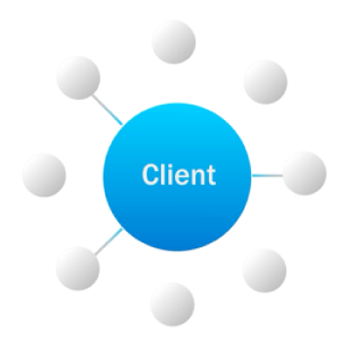
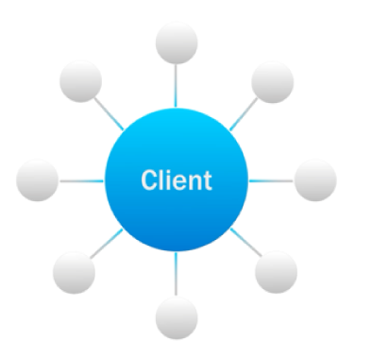
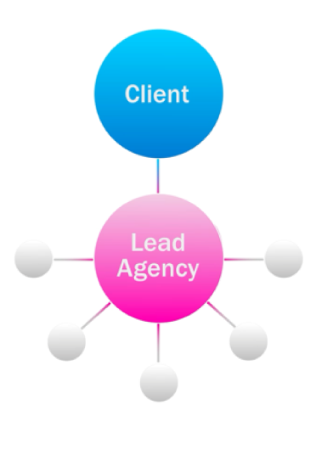
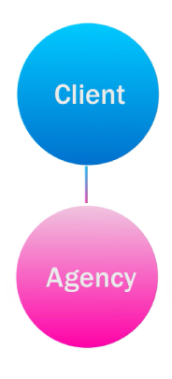
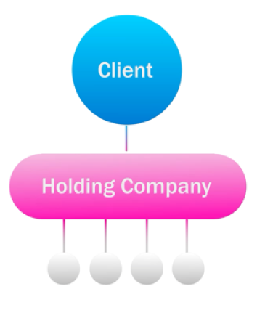
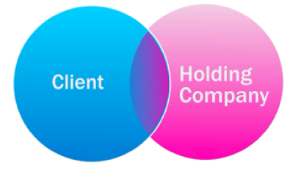
要素一：内部精细管理
根据市场六大代理商业务模型形态精细规划，合作模式精准化
R3胜三的六大代理商模型
灵活型代理商模式
整合型代理商模式
集团制代理商模式
自由代理模式
最优代理商混合模式
主代理商领导模式
一站式模式
集团指派模式
集团定制模式
更高的灵活性
更高的稳定性
灵活性：服务灵活度高，可根据品牌需求灵活选择匹配
性价比：可进行比价选择更具有价格优势的代理商
整合性：策划和创意能力的更统一；KPI考量标准更统一
统筹性：协助品牌协调IMC营销统筹规划，落地品牌策略
定制性：根据集团需求定制化业务板块和服务范畴
掌控性：服务内容和流程更加匹配集团需求，价格透明度高

Slide 79
Factor 1: Detailed Internal Management
Analyze the in Market Agency Models to design the ‘Best-fit’ Model
R3 Agency Models
Flexible Agency Models
Integrated Agency Models
Holding Group Models
MULTIPLE
BEST-IN-CLASS
LEAD AGENCY
HOLDING COMPANY/
SISTER AGENCIES
HOLDING COMPANY/
CUSTOM AGENCY
FREE AGENT
ONE-STOP SHOP
More Flexible
More Stable
Flexibility: High service flexibility, allowing flexible selection according to brand needs
Cost-effectiveness: Can compare prices to select agencies with price advantages
Integration: More unified planning and creative capabilities; more consistent KPI evaluation standards
Coordination: Assist brands in coordinating IMC marketing planning, implementing brand strategies
Customization: Customize business segments and service categories according to group needs
Government: Service content and processes better match group needs, with high price transparency

Slide 80










要素一：内部精细管理
洞察代理商的优势与短板，根据需求精细匹配最优合作伙伴
一般
较优
 |  | 创意 代理商 | IMC 代理商 | 媒体采买 代理商 | 社交 代理商 | 视频制作 代理商 | KOL采买 代理商 | MCN 代理商 | 数据 洞察平台 | 线下执行 代理商 | 电商运营 代理商
策划
执行
采买
服务
数据
整合策划
创意内容策划
内容/物料制作
协调能力
精细化高质执行
资源价格优势
资源采买效率
客户服务优势
数据库搭建
数据洞察、监测工具和能力

Slide 81
Factor 1: Detailed Internal Management
Insight into the strengths and weaknesses of the agency, match the optimal partner according to the requirements
General
Superior
 |  | Creative Agency | IMC Agency | Media Agency | Social Agency | Production House | KOL Buy Agency | MCN | Data-Analysis Agency | BTL Agency | EC Operation Agency
Planning
Execution
Buying
Service
Data
IMC Planning
Creative
Content & Material Production
Coordination Capability
Efficient Execution
Pricing Advantage
Procurement Efficiency
Client Service
Database Construction
Data Insight, Monitoring Tools, and Capabilities

Slide 82






要素一：内部精细管理
代理商管理精细管理，需具备以下五大方面的关键要素
流程监管
工作范畴划分
文档规范化
决策透明
需求明确的需求方
需求方的供应商
年度：进度同步，规范文档格式
内部资源整合
合规审计
执行方
有效的内部合作
风险控制
资源提供方
Campaign：标准化文档（采购需求、采购订单、审批流程、计划变更、采买计划表、订购流程、服务完成确认、代理商评估等)
进度管理
制定明确的KPI
制定年度计划时同步预估信息并进行资源预订
人员关键职责确定
行为准则
日常：每月更新整体规划、支出和KPI，代理商沟通规范，代理商名单和费用数据库填充
使用人员和采买流程人员同时监督campaign计划和执行
外部支持（第三方数据）
量化KPI指标

Slide 83
Factor 1: Detailed Internal Management
Agency management requires the following five key elements
Process supervision
Division of work scope
Standardization of documents
Transparent decision-making
Clear requirements from the demander
Venders for the demander
Annual: Sync progress, standardize document formats
Internal resource integration
Compliance audit
Executors
Efficient internal collaboration
Risk control
Resource providers
Campaign: Standardized documents (purchase requisitions, purchase orders, approval processes, change requests, procurement plans, ordering processes, service completion confirmations, agency evaluations, etc.)
Progress management
Establishment of clear KPIs
Sync forecast information and reserve resources when annual planning
Definition of key persons’ responsibilities
Rules of conduct
Always-on: Update overall plans, expenses, and KPIs monthly, standardize communication with agencies, and update agency lists and expense databases
Controller and procurement staff simultaneously oversee campaign planning and execution
External support (the third party data)
Quantification of KPI index

Slide 84


要素二：外部有效协同
根据营销重点与资源特征，定制资源方合作模式，营销合作效率最大化
市场主
代理商
外部资源
典型资源类型
内容整合度
投放与合作效率
投放与合作有效性
执行灵活度
整合营销导向
资源自采导向
第三方采买导向
资源方直接为市场主做整合营销策划、内容产出和资源落地
优质资源由市场主直连直采，代理商负责执行沟通
由代理商负责，推荐、沟通、采购、管理资源方及执行
媒体平台方、IP资源、
非标广告资源
媒体平台方、明星&KOL资源、跨界品牌、非标广告资源
媒体平台方、明星&KOL资源、跨界品牌、非标广告资源
较强
中等
较弱

Slide 85
Factor 2: Effective External Synergy
According to the marketing focus and resource characteristics, customize the cooperation model of resource parties, and maximize the efficiency of marketing cooperation.
Marketer
Agency
External Resource
Typical resource types
Content integration
Media buy and collaboration efficiency
Media buy and collaboration effectiveness
Execution flexibility
Integrated marketing orientation
Marketing-buying resource orientation
Third-party buying orientation
Resource providers directly undertake integrated marketing planning, content creation, and implementation for marketers
High-quality resources are directly bought by marketers, with agencies responsible for execution and communication
Agencies are responsible for recommending, communicating, buying, managing resource providers, and executing tasks.
Media platforms, IPs, Non-standardized resources
Media platforms, Celebrities & KOLs, Cross-over brands, Non-standardized resources
Media platforms, Celebrities & KOLs, Cross-over brands, Non-standardized resources
Strong
Moderate
Weak

Slide 86







要素二：外部有效协同
两大准则三大方面，规避痛点，营销合作效果最大化
资源合作的两大准则
1
以品牌策略导向
规划与选择
PLANNING
合作使用
EXECUTION
效果评估
EVALUATION
以品牌策略指导资源选择和使用，将资源融合进品牌市场规划组合之中，突出品牌印记形成品牌资产
前置收集资源信息
时刻关注市场动态
根据策略和人群
定制化权益使用
根据市场营销目的
设定针对性评估维度
2
资源使用定制化
策略结合长线规划
纳入全年营销规划
避免使用同质化
区隔化创意和应用
同类合作效果数据累积
持续跟踪对比
根据品牌需求和营销活动进行定制化权益使用，以及做到使用的区隔性，避免资源应用同质化
优质资源提前洽谈
抢占先发先机

Slide 87
Factor 2: Effective External Synergy
Maximize marketing collaboration effectiveness by avoiding potential pain points
Principles
1
Brand Strategy Leading
PLANNING
EXECUTION
EVALUATION
Guided by brand strategy, integrate resources into brand marketing plans to highlight brand identity and build brand assets
Stay updated on market trends and proactively collect resource information
Customize the use of rights based on strategy and TA
Set targeted evaluation dimensions based on marketing objectives
2
Customized Resource Utilization
Integrate it into the annual marketing plan
Ensuring differentiation in creative and resource utilization
Accumulate data on similar cooperation effects and continuously track and compare them
Tailor the use of resources according to brand needs and marketing activities, ensuring differentiation in usage and avoiding homogenization of resource application
Negotiate with high-quality resources in advance to gain an early advantage

Slide 88
要素三：科学评估体系
以营销目标为评估核心准则，两步走建立科学评估体系
PRINCIPAL
定义营销目标
Define Objective And Ambition
PHASE 1
PHASE 2
定义评估维度
Identify Metrics That Matters
科学量化评估
Make It Accountable
以品牌市场营销策略、目标、现状为导向
建立自身短-中-长期合理评估体系
合理设定细分评估维度
效果评估
效能评估
合规评估
合理设定评估权重以及基础量化标准
引入数据追踪和解决方案

Slide 89
Factor 3: Rational Evaluation System
Marketing objectives as the core criteria, establish an accountable and reasonable evaluation system through two steps:
PRINCIPAL
Define Objective and Ambition
PHASE 1
PHASE 2
Identify Metrics That Matters
Make It Accountable
Guided by brand marketing strategy, objectives, and current status
Establish a reasonable evaluation system for short, medium, and long-term goals
Set reasonable segmented evaluation dimensions
Performance evaluation
Efficiency evaluation
Compliance evaluation
Reasonably set evaluation weights and basic quantitative standards,
Data tracking and solutions

Slide 90



要素三：科学评估体系
合理结合三大方向，建立科学评估模型和量化标准
合规评估
效能评估
效果评估
合作风险是否达到最低
资源投资率是否达到最优
营销效果是否达到预期
管理风险最低化 营销效果最大化
多维度合规性评估
成本和预期测算+比对同类数据标准
不同营销目标，各指标权重不同
投资
成本
市场价格是否
具有优越性
品牌
声量
背景合规
财务
合规
品牌
力
执行合规
效果评估
四大维度
合作方背景
财务背景和流程
执行操作和材料
预期回报是否
满足目标
预期
回报
同类
比对
比对同类数据
是否在基准线
销售
转化
社交
影响力

Slide 91
Factor 3: Rational Evaluation System
Establishing a rational evaluation model and quantitative standards from three dimensions
Compliance evaluation
Efficiency evaluation
Performance evaluation
Minimize cooperation risks
Minimize Resource Investment Rate
Achieve expected performance
Minimize management risks Maximize marketing effects
Multi-dimensional
compliance evaluation
Cost and expected return calculation + comparison with benchmark
Different marketing objectives have different indicator weights
Investment cost
The market price has superiority
Brand
SOV
Brand power
Back-ground
Financial
Execution
效果评估
四大维度
Partner Background
Financial Background & Process
Execution &
GR Report
The expected return meets the target
Expected return
Benchmark
The data is above benchmark
Conversion
rate
Social influence

Slide 92




要素三：科学评估体系
以效果评估为例，结合第三方外部数据追踪和解决方案，让效果评估更具量化性
Brand Power
Brand Impression
Social Impact
Conversion & Sales
维度
维度
维度
维度
品牌识别度
品牌好感度
品牌认知度增长指数
品牌声量占比增长率（SOV）
品牌消费者互动占比增长率（SOE）
品牌关键词搜索同比增长率
品牌GMV同比增长率
品牌新客同比增长率
消费者复购率
监测工具/源
监测工具/源
监测工具/源
监测工具/源
第三方品牌健康度年度/半年度调研（BHT）
第三方监测公司基于全网和全社交平台数据监测
第三方监测公司基于全网和全社交平台数据监测
电商平台后台数据
品牌销售数据

Slide 93
Factor 3: Rational Evaluation System
In the case of effectiveness assessment, combining third-party external data tracking and solutions makes the evaluation more accountable
Brand Power
Brand Impression
Social Impact
Conversion & Sales
Dimension
Dimension
Dimension
Dimension
Brand differentiation
Brand preference
Brand awareness growth index
Share of voice (SOV) growth rate
Share of engagement (SOE) growth rate of brand consumers
YOY growth rate of brand keyword searches
YOY growth rate of brand GMV
YOY growth rate of new brand customers
repurchase rate
Tracking tool/resource
Tracking tool/resource
Tracking tool/resource
Tracking tool/resource
Third-party brand health survey (BHT) annually/biannually
Third-party monitoring companies based on data from internet and social platforms
Third-party monitoring companies based on data from internet and social platforms
E-commerce platform backend data
Brand sales data

Slide 94
Thank You!

